Slide 1
JVM Basic Memory & GC Addition

Slide 2
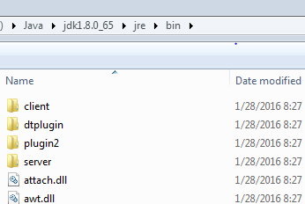
JVM Location Path
%JAVA_HOME%\bin\java.exe
%JAVA_HOME%\bin\javaw.exe
%JAVA_HOME%\bin\javaws.exe
%JAVA_HOME%\jre\bin\client\jvm.dll
%JAVA_HOME%\jre\bin\server\jvm.dll
Launcher
Argument to start:
-client start quickly, save memory
-server heavy, use much optimization for
long-time running

Slide 3
JVM Version
java –version
java version “1.7.0_67”
Java(TM) SE Runtime Environment(build 1.7.0_67-b01)
Java HotSpot(TM) Server VM(build 24.65-b04,mixed mode)
java –client –version
java version “1.7.0_67”
Java(TM) SE Runtime Environment(build 1.7.0_67-b01)
Java HotSpot(TM) Client VM(build 24.65-b04,mixed mode)

Slide 4
JVM Options
standard -
all jvm must support
ex: -version -jar
optional -X
ex: -Xms -Xmx
optional and unstable -XX:
total 700+ production 300+
ex: -XX:+PrintGC -XX:OldSize=100m

Slide 5

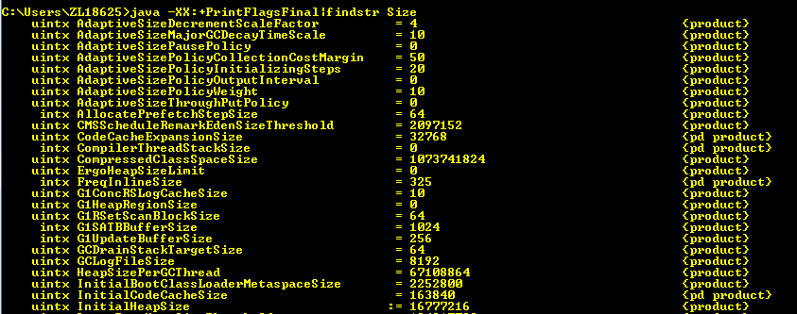
JVM Options
Print one or more arguments
Java –XX:+PrintFlagsFinal | findstr

Slide 6
Compilation
Java -Xint interpreted mode
Java -Xcomp compiled mode
Java -Xmixed mixed mode (default)
two times of compilation:
1. javac
2. JIT ( Just In Time ) – Dynamic Compilation

Slide 7
HotSpot-JIT
Method
Basic Unit Of Compilation
server 10000
client 1500
-XX:CompileThreshold
Invocation Counter
Count by times of execution
Back Edge Counter ( loop )
CounterDecay - If an application has running for a long time, in theory,
all methods will be over threshold.
HotSpot introduces CounterDecay, if the counter has
not been up to threshold in a certain time, it will be
reduced by half.

Slide 8
OSR- On Stack Replacement
intepret/run
method
(.class)
reach threshold?
no
yes
loop
JIT
OSR
VM Pause
machine
code

Slide 9
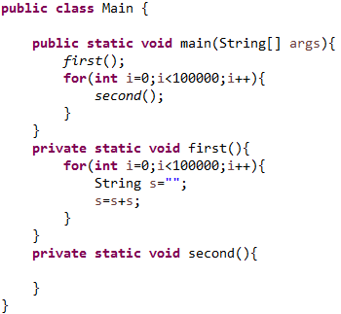
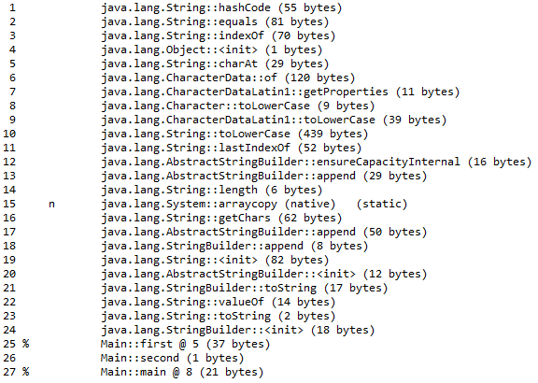
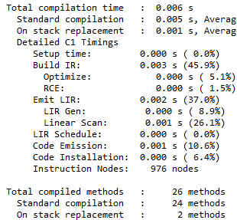
-XX:+PrintCompilation -XX:+CITime

Slide 10
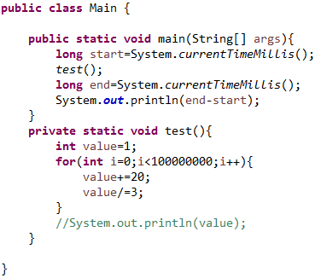
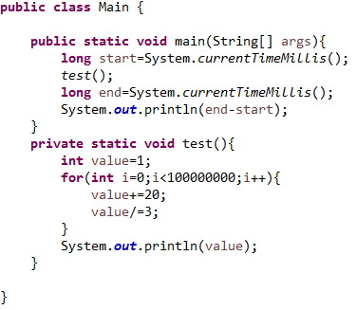

Slide 11
Memory & GC

Slide 12
JVM Architecture
class loader subsystem
class files
method area
heap
stacks
PC register
native method stack
execution engine
native interface
native libraries

Slide 13
Runtime Data Areas
Heap
OutOfMemoryError
Method Area
OutOfMemoryError – too many classes
Stack
StackOverflowException- Recursive/ terrible loop

Slide 14
Stack
Stack frame
a stack frame
one method invoke
args
local variables
middle results
…
32x-512k 64x-1024k default
-Xssnk
-XX:ThreadStackSize

Slide 15
Escape Analysis
Optimize by analysing the scope of object
-XX:+DoEscapeAnalysis ( open default ) jdk1.7
The object that is not accessed by other threads
is called Non-Escape object.
Synchronization Elimination
-XX:+EliminateLocks ( open default ) jdk1.7
Scalar Replacement
-XX:+EliminateAllocations ( open default ) jdk1.7
will not use any lock
Allocate object in stack
Object size

Slide 16

Heap
Java -Xms64m
Java -Xmx512m
Java -XX:InitialHeapSize=64m
Java -XX:MaxHeapSize=512m
avoid too large
Thread-Shared
alloc pointer
used
free
jvm make synchronization for new operation, which costs much.
concurrent

Slide 17

Heap TLAB
TLAB- Thread Local Allocation Buffer
a data area in heap for each thread, avoid conflict for new operation
-XX:+UseTLAB (open default)
-XX:TLABSize
alloc pointer
TLAB
new
stack
TLAB
Shared Heap
Object size

Slide 18
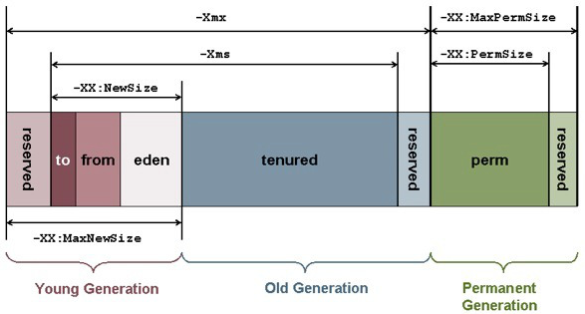
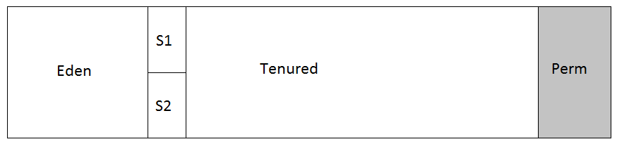
Generation

Slide 19
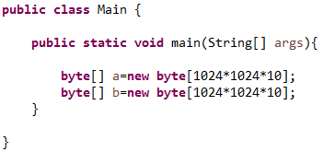
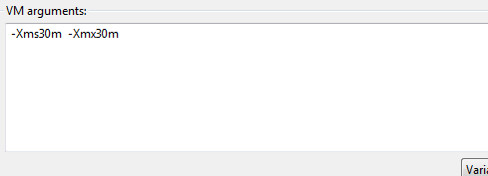
Generation
-XX:NewRatio old/young (default =2)
-XX:SurvivorRatio eden/survivor (default=8)
-XX:PretenureSizeThreshold
-XX:MaxTenuringThreshold (default=15)
-XX:+PrintTenuringDistribution
-XX:MinHeapFreeRatio (default=40)

Slide 20
Perm Gen
Perm Gen ( only in HotSpot)
Method Area ( JVM Standard , in each jvm)
Metaspace( Perm Gen is dropped in Java SE 8, Metaspace is introduced)
class information
literals ( not contains final )
static properties
String.intern ( in some jvm of old version)
-XX:PermSize=20m
-XX:MaxPermSize=60m

Slide 21
Direct Memory
Directly allocated by jvm, doesn’t belong to runtime data area.
1. sun.misc.Unsafe allocateMemory( ) freeMemory( )
2. NIO
ex: ByteBuffer CharBuffer IntBuffer
OS Level
recommended
Frequent IO
Store large, long-lived object
default max size=heap size
-XX:MaxDirectMemorySize

Slide 22
Memory Classification
Stack (not shared , inside thread)
Heap
Perm Gen (Out of Heap)
not enough full gc
Direct Memory (Out of JVM Architecture)
not enough full gc
GC

Slide 23
Tips
Reduce the amount of short-life object that escape into tenured .
1. Necessary to divide the large object, try to make it less than half of survivor.
2. Avoid that too many little and long-life objects exist at the same time,
if possible, let them alternate.
Although caches could make application have good performance, they will be transferred into tenured finally, obviously it’s not scientific that tenured has areas which will not be collected forever.
1. If there are some long-life data related with Database or Internet, local
disk could be chosen.
2. For some cache in local machine, Direct Memory could be chosen.

Slide 24
Garbage Collection

Slide 25
GC Classification
Minor GC - young gen
Major GC - tenured gen ( slow 10 times than minor gc )
Full GC - heap, perm gen, direct memory
System.gc( ) Runtime.getRuntime( ).gc( )

Slide 26
Garbage Mark And Collection
GC Roots Tracing
referred by java stack
referred by native stack
referred by static property
Root Object
Collection Algorithm
Copy
-young gen
Mark-Sweep/Mark-Compact/Mark-Sweep-Compact
-tenured gen, perm gen

Slide 27
PermGen GC
Preconditions to collect class
All instances created from the class have been swept.
Java.lang.Class Object is not referred by any others.
The ClassLoader to load the class has been swept.
Cause too many classes
tomcat
Dynamic Agent
Spring
JSP
-Xnoclassgc

Slide 28
Garbage Collector
Young Generation
ParNew
Parallel
Scavenge
Serial
3
G1
2
Parallel Old
CMS
1
Serial Old
Tenured Generation

Slide 29
Garbage Collector
1. Serial
Serial / Serial Old (default in -client)
Single Thread, need pause user thread
log analysis
Serial - DefNew ( Default New)
Serial Old - Tenured, Perm
Start options
-XX:+UseSerialGC
-XX:+UseConcMarkSweepGC -XX:-UseParNewGC ( Serial-CMS )
-XX:+UseParNewGC ( ParNew-SerialOld )
-XX:+UseParallelGC -XX:-UseParallelOldGC ( PS- Pold)

Slide 30
Garbage Collector
2. Parallel - Throughput First
Parallel Scavenge/ Parallel Old
Multi Thread, need pause user thread for mark and sweep
log analysis
Parallel Scanvenge - PSYoungGen
Parallel Old - ParOldGen
Parallel Scavenge
GC Ergonomics
control Heap dynamicly

Slide 31
Garbage Collector
3. Concurrent - Pause Time First
ParNew / CMS (Concurrent Mark Sweep)
cpu1
cpu2
cpu3
cpu4
Initial
Mark
Concurrent
Sweep
Concurrent
Mark
Remark
Pause Time
Ergonomics
-XX:CMSTriggerRatio (default=80)
Throughput

Slide 32
Addition

Slide 33
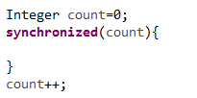
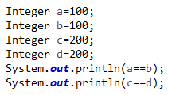
Other Pieces
Thread name- setName( )
while(true){
Thread.yield();
if(flag){
…
}
}
Spin Lock
Function Program
Thread Pool
Count of thread in the pool ought to be related with count of processors.
1. computation intensive - N+1
2. IO intensive – 2N+1
3. DB operation intensive- connection count in connection pool
Runtime.getRuntime.availableProcessors( )

Slide 34
JVM Options
-XX:+PrintFlagsFinal | findstr
-XX:+PrintGCDetails
-XX:+PrintHeapAtGC
-Xloggc:/var/output.log
-XX:+HeapDumpOnOutOfMemeryError -XX:HeapDumpPath=“/var/dump.hprof”

Slide 35
Tools
jinfo
jstat
jstack
jmap
jhat
Graphical
Jmeter
JProfiler

Slide 36
Tools
jinfo
Display
jinfo -flag <name> <pid>
ex: jinfo -flag NewSize 6720
Modify ( only for managable)
jinfo -flag [+|-] <name> <pid>
jinfo -flag <name>=<value> <pid>
ex: jinfo -flag +HeapDumpBeforeFullGC 6720
jinfo -flag HeapDumpPath=“/var/dump.hprof” 6720

Slide 37
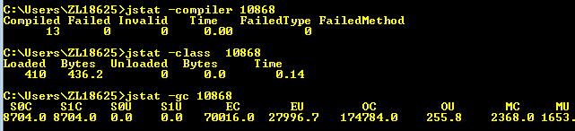
Tools
jstat- get statistics data on running process
Class loaded
Compilation
GC

Slide 38
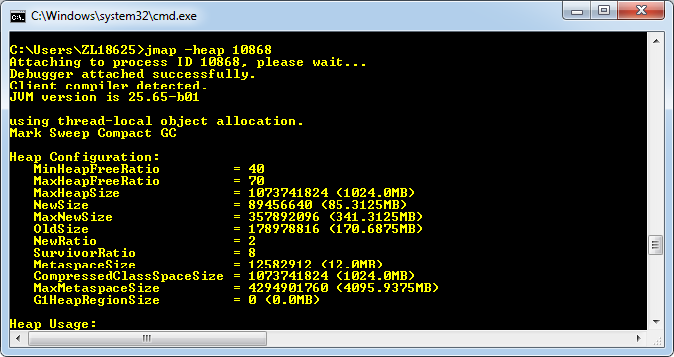
Tools
jmap – get quick map of running process’s heap, could dump without OOM

Slide 39
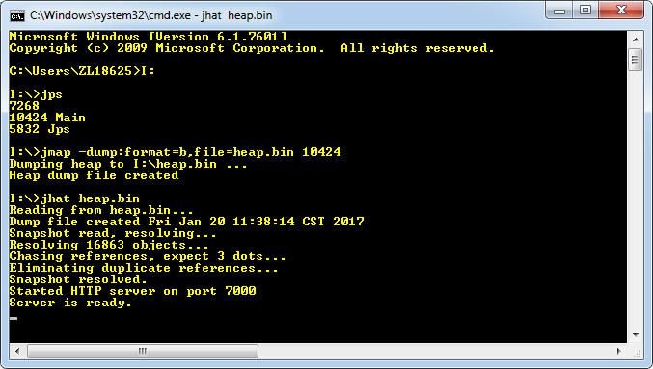
Tools
jmap & jhat

Slide 40
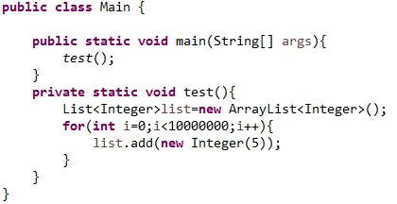
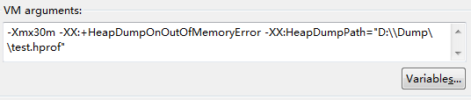
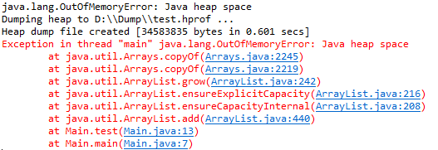
Example-1

Slide 41
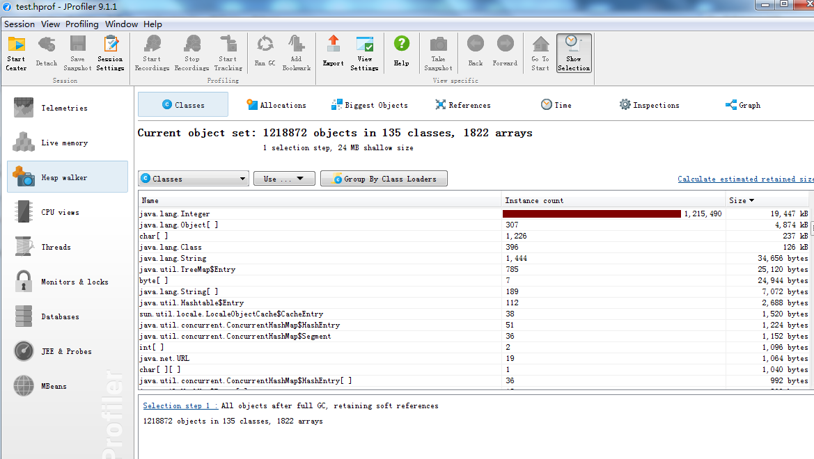

Slide 42
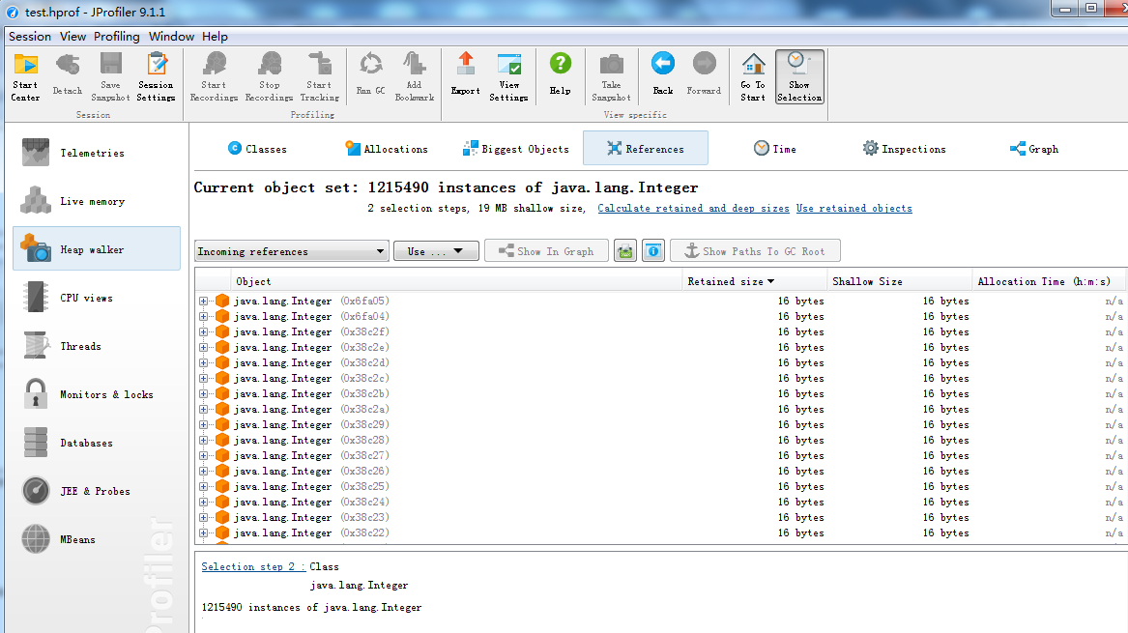

Slide 43
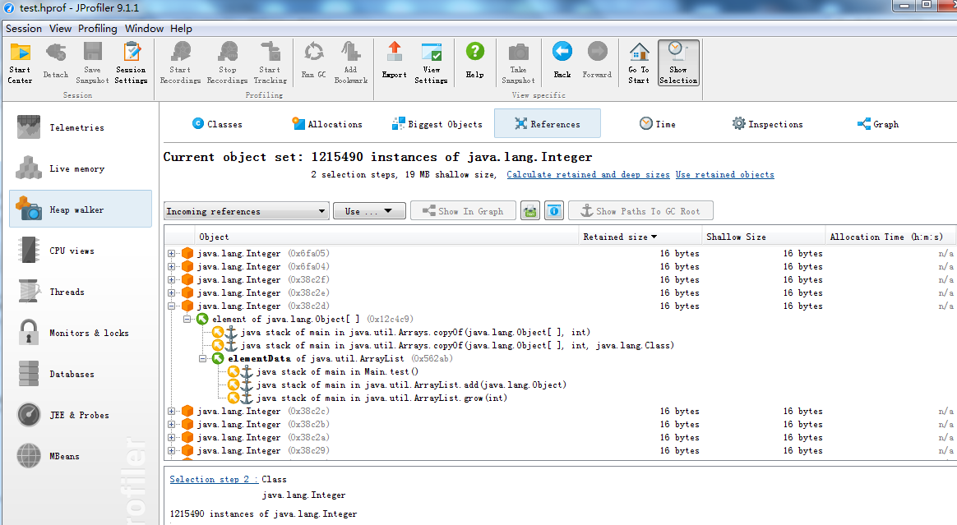

Slide 44
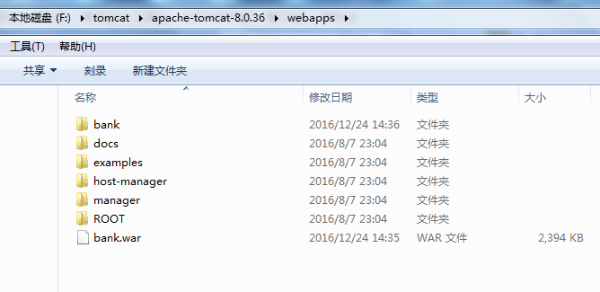
Example-2

Slide 45
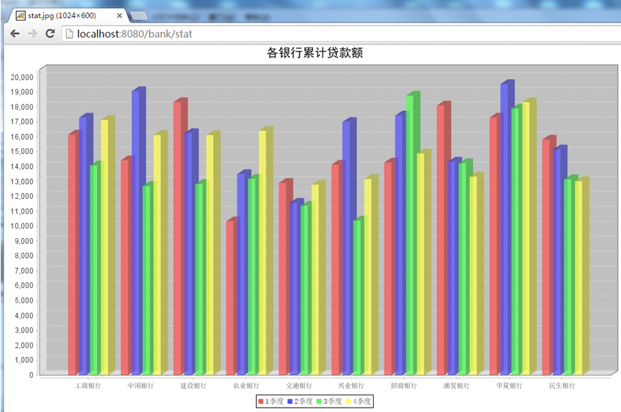

Slide 46
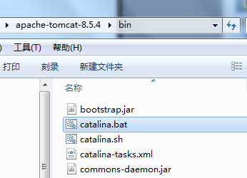
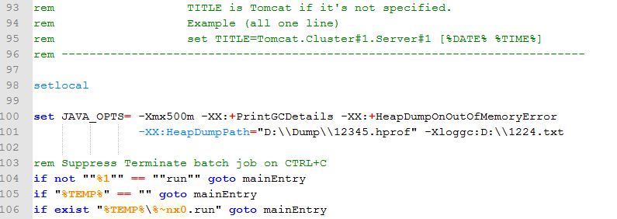

Slide 47
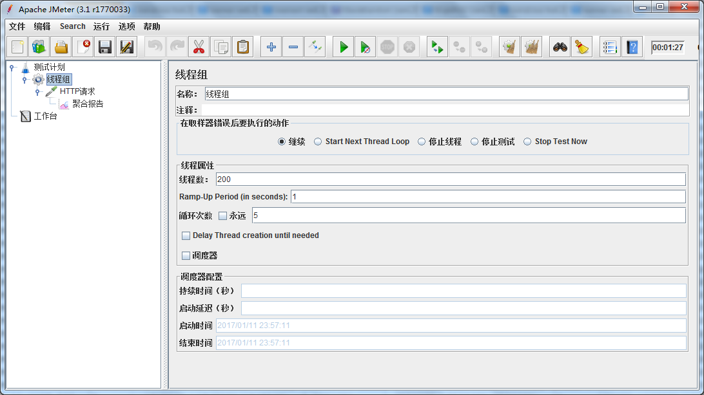

Slide 48
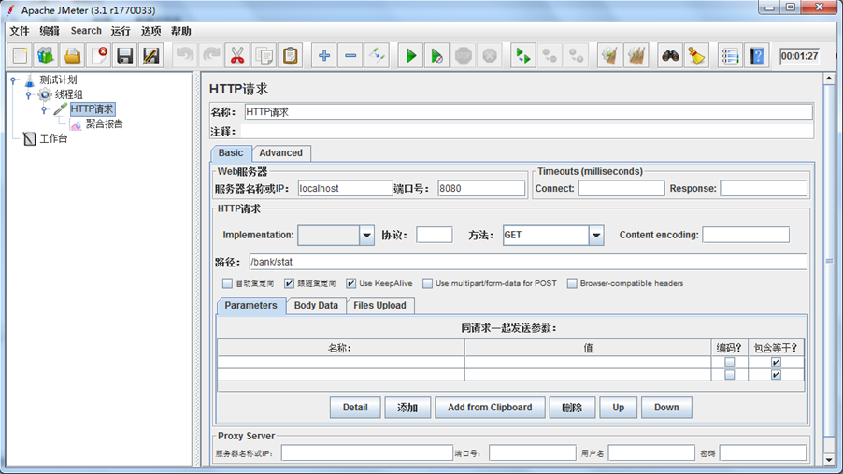

Slide 49
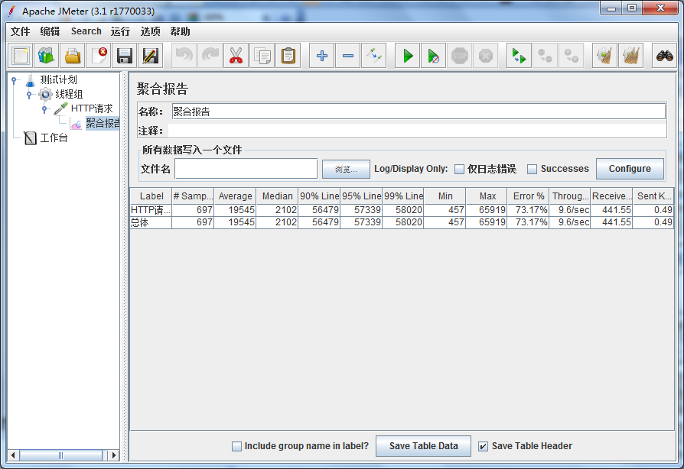

Slide 50
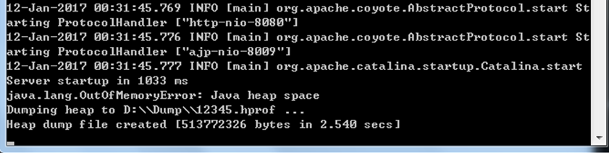
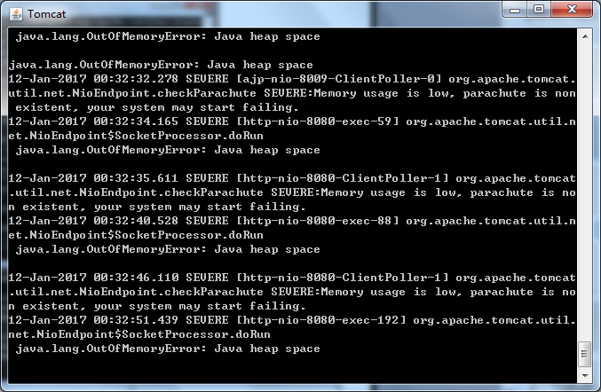

Slide 51
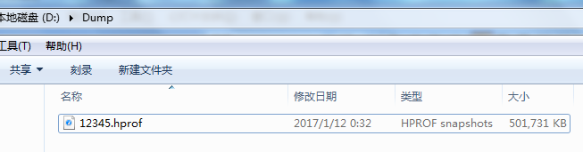
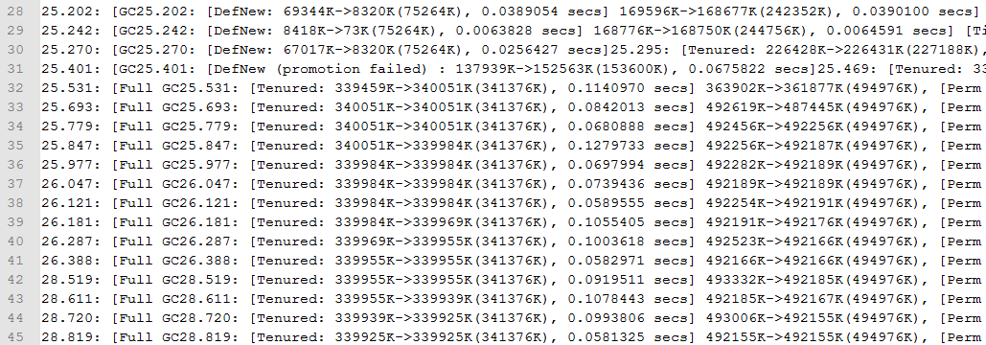

Slide 52
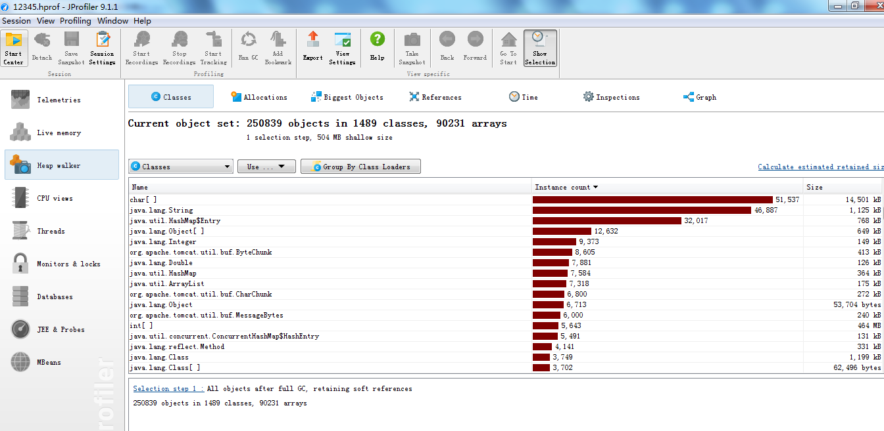

Slide 53
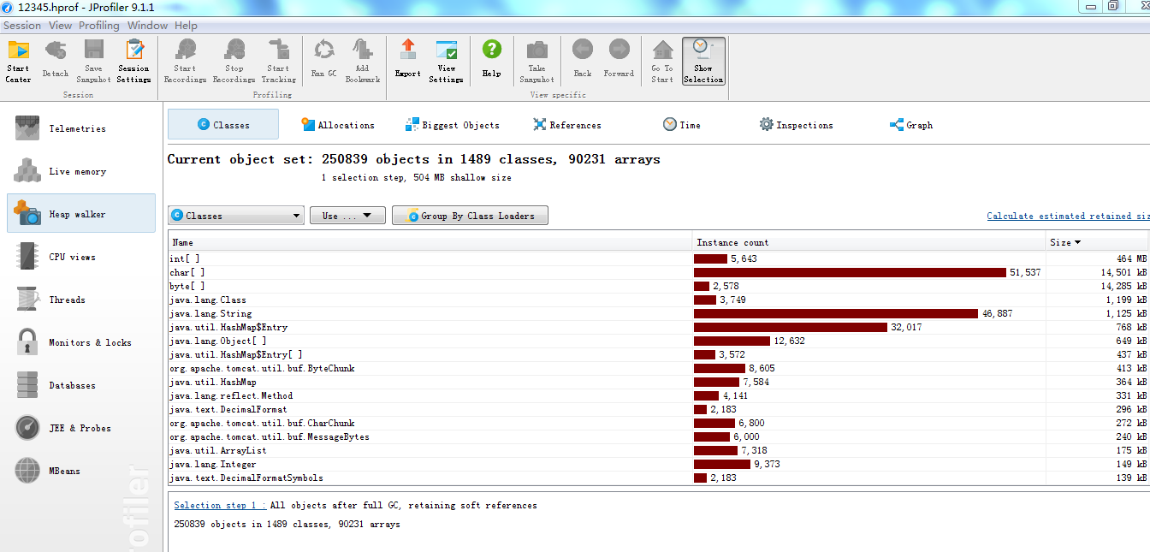

Slide 54
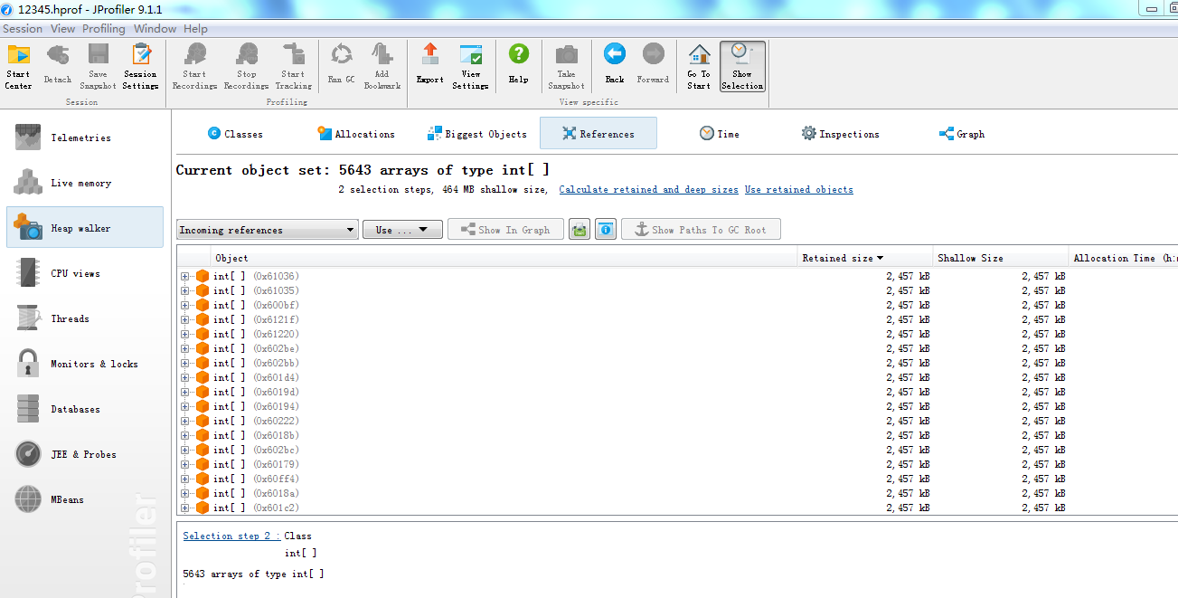

Slide 55
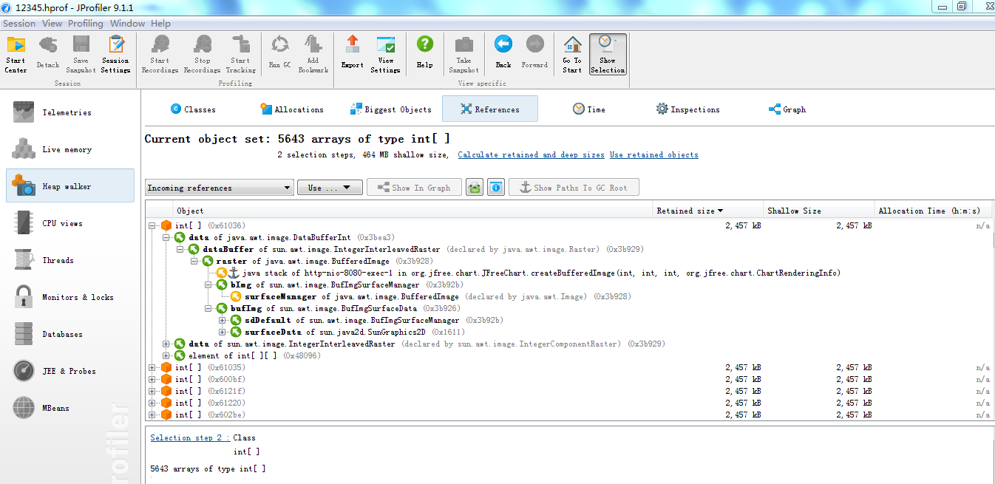

Slide 56
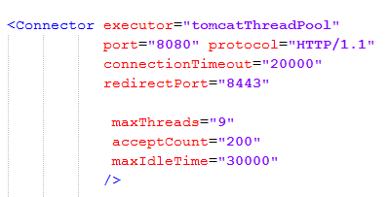

Slide 57
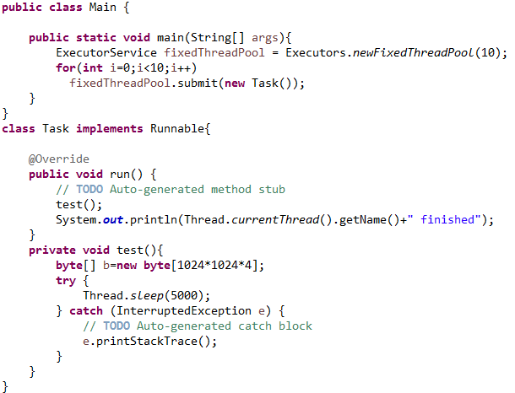
Example-3

Slide 58
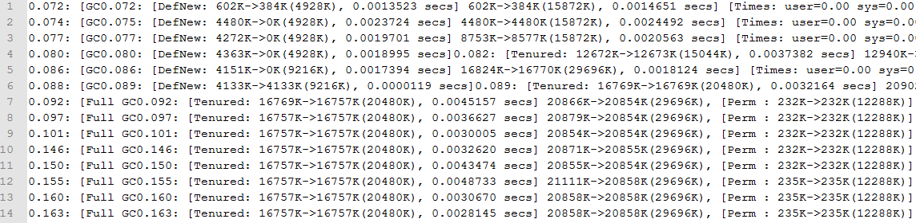

Slide 59
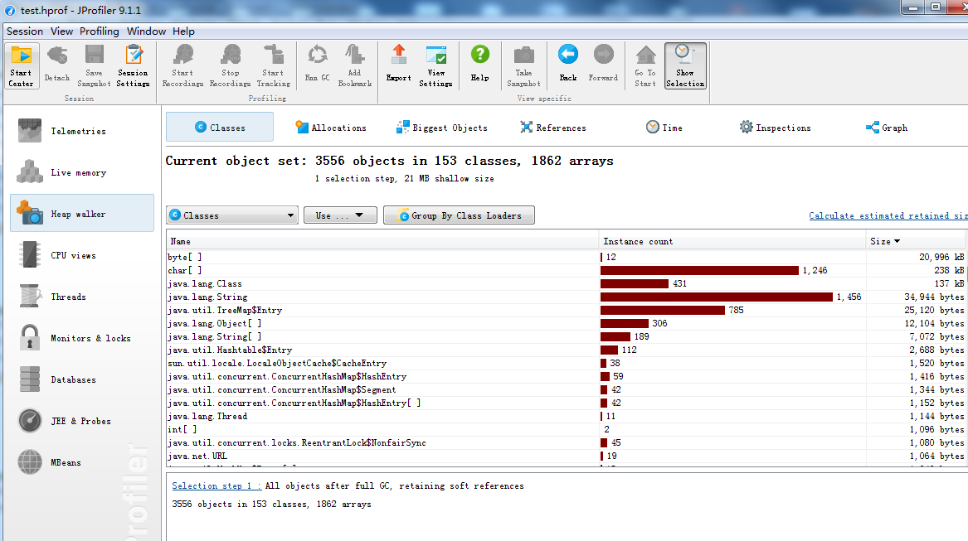

Slide 60
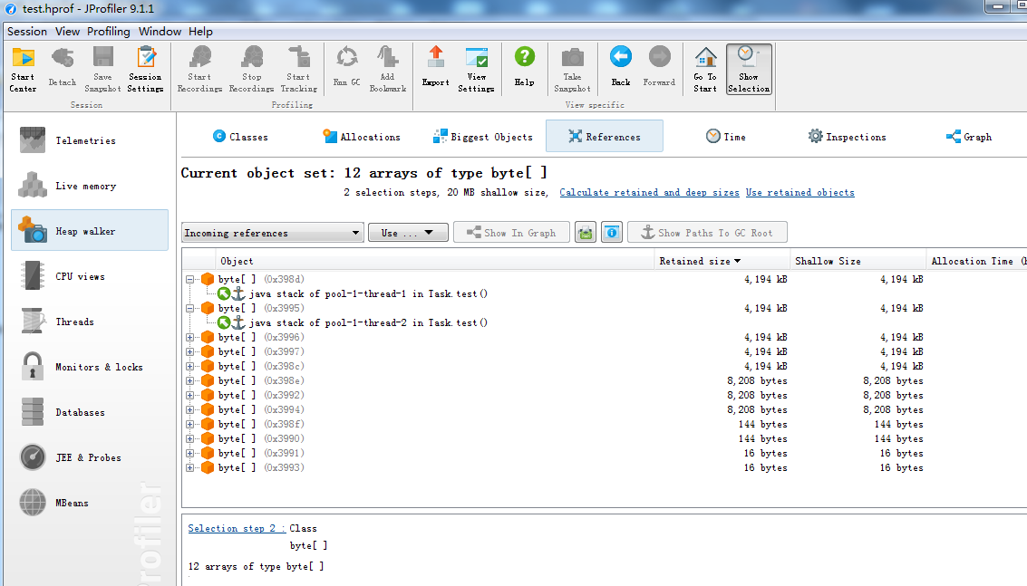

Slide 61


Slide 62
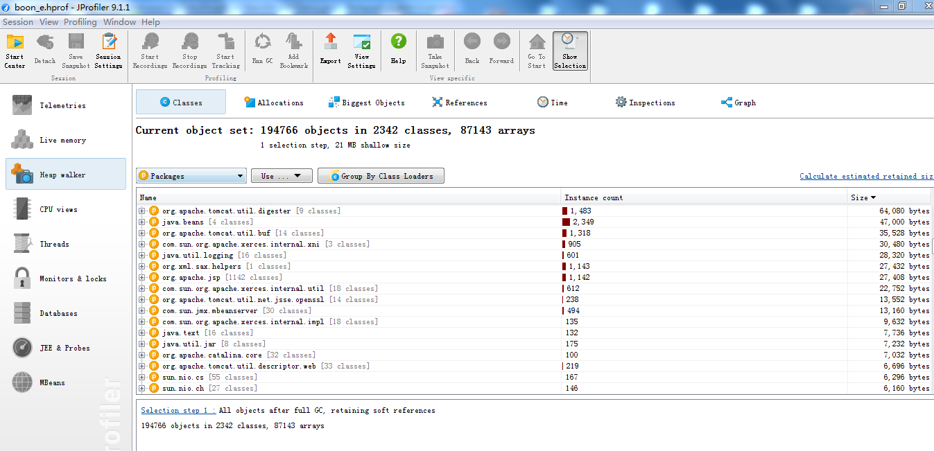
Example-4

Slide 63
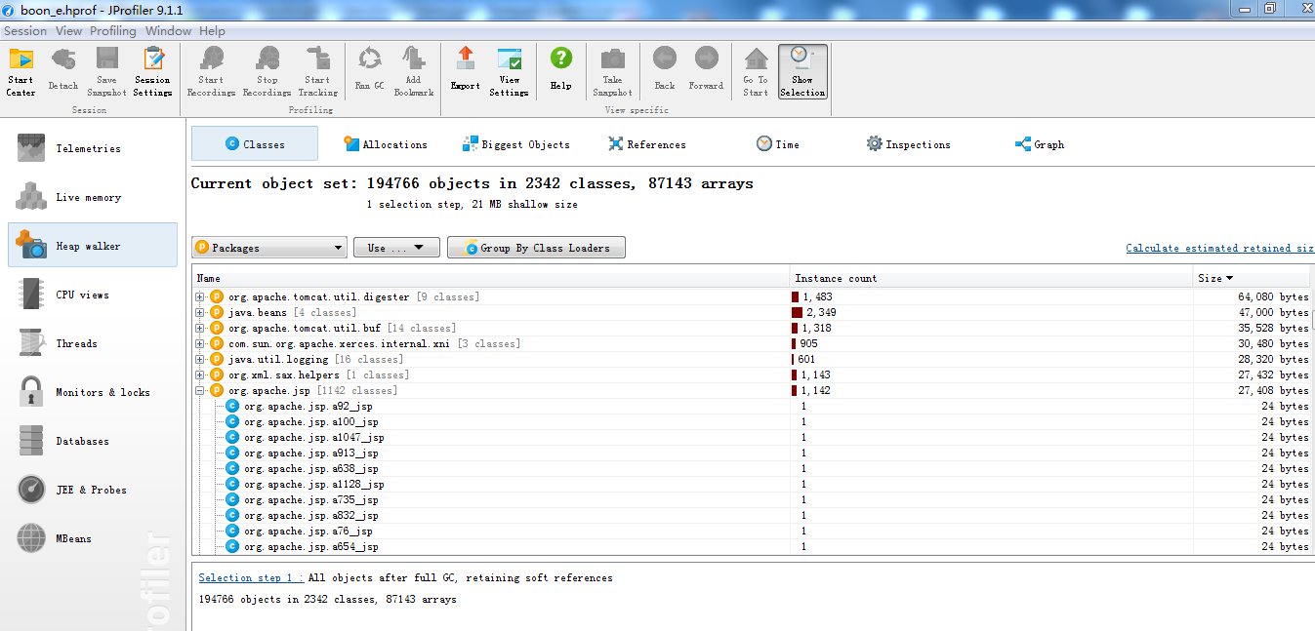

Slide 64
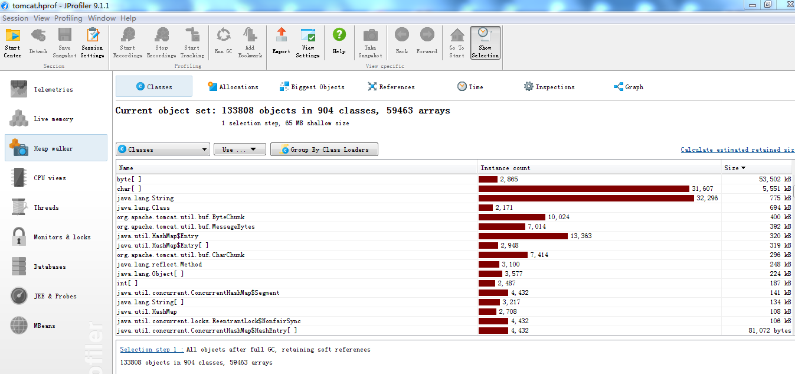
Example-5

Slide 65
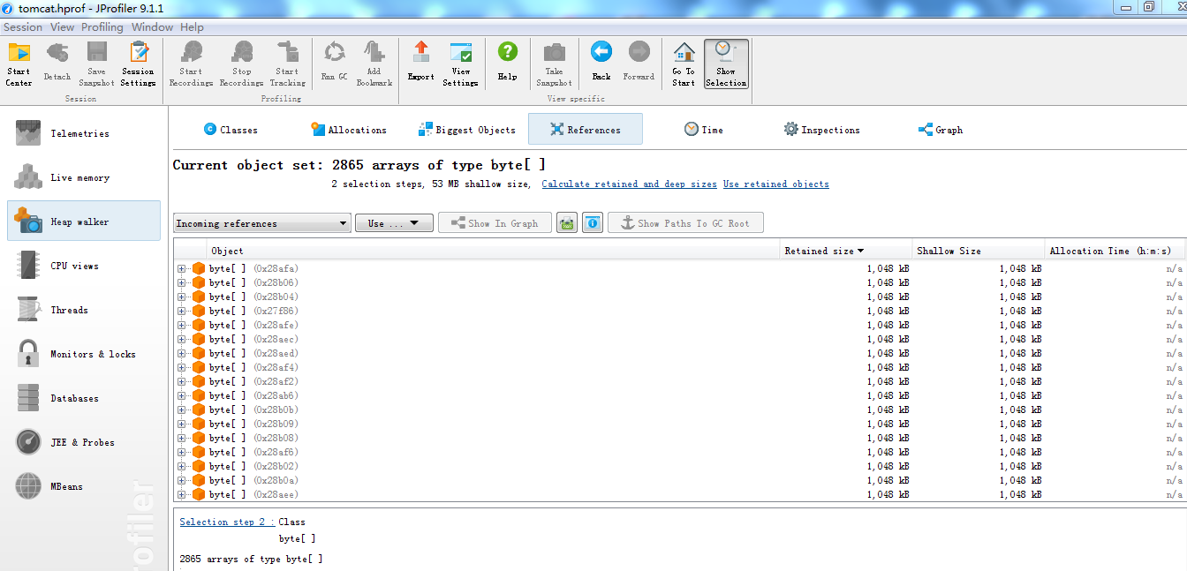

Slide 66
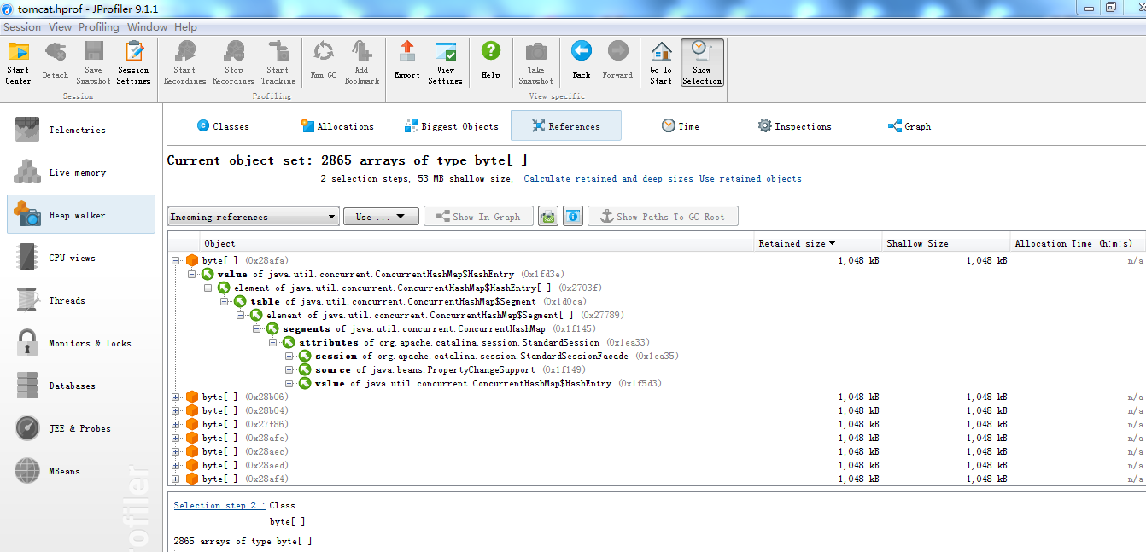

Slide 67
Tips
Perm Gen (class amount)
Direct Memory (nio)
Full GC
Heap
short-life object - try to divide it into small pieces.
long-life object
small- choose to let them alternate
large- choose to put them into Direct Mem or Disk

Slide 68

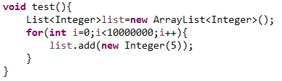

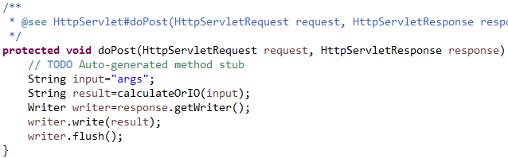
long-life Objects
Global Ref
High Concurrency
hot method

Slide 69
JVM Architecture
class loader subsystem
class files
method area
heap
stacks
PC register
native method stack
execution engine
native interface
native libraries

Slide 70
Memory Classification
Stack (not shared , inside thread)
Heap
Perm Gen (Out of Heap)
not enough full gc
Direct Memory (Out of JVM Architecture)
not enough full gc
GC

Slide 71
Generation

